Slide 1
Preparation for Control work #2

Slide 2
Topics
Behavioural and structural UML diagrams (static and dynamic), their purpose and elements: use case, activity, state, sequence, class, component diagrams.
Advantages of architecture document. Architectural templates: MVC, repository, layered, client-server.
Component/module. What is component/module? What is difference between module and object?
Cohesion and coupling. Levels of cohesion and coupling.

Slide 3
UML
Difference between static and dynamic UML model.
List any 3 UML diagrams that can be used to model the dynamic behavior of the system.
List any 3 UML diagrams that can be used to model static system structure.
Explain the purpose of the diagrams you listed.

Slide 4
UML
What does the generalization in the class diagram represent?
What does the composition relation in the class diagram represent?
What does the aggregation relation in the class diagram represent?
Give examples. Which implementation does it fit programmatically?

Slide 5
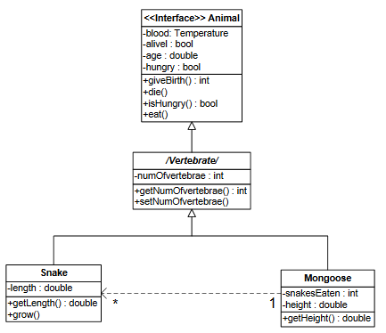
Examine the UML diagram
What is the relation between VERTERBRATE ANIMAL and ANIMAL?
What is the relation between SNAKE and ANIMAL?
What type of association is between MANGUST and SNAKE?
Can 2 MANGUSTS eat 1 SNAKE?
Is there any error in this diagram?

Slide 6
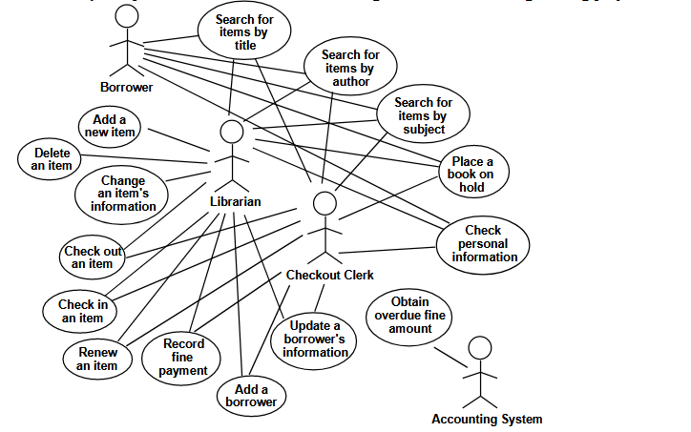
Examine the UML diagram provided. This DIAGRAM is hard to read - simplify it.

Slide 7
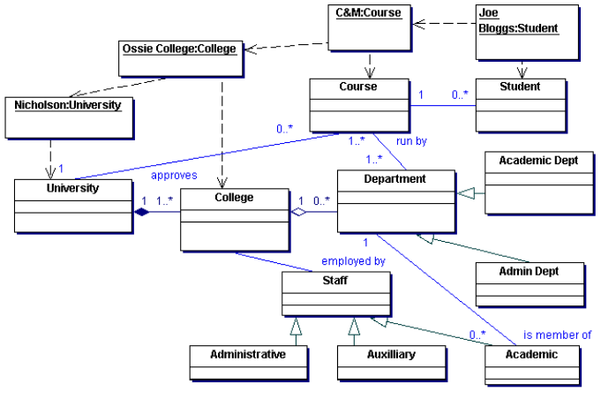
What UML diagram is in picture? What are the elements of this diagram.

Slide 8
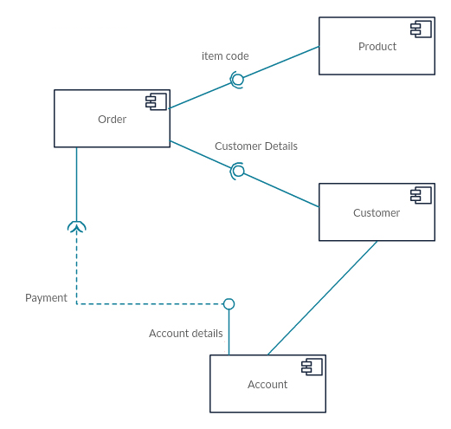
What diagram is given in the picture? What elements can you identify?

Slide 9
Draw state diagram for chronometer.

Slide 10
Architecture
The company wants to convert a desktop application that uses a local database into a web application that will have access to the database on the server. Discuss the architecture of both systems and identify the steps required for conversion.
What are Architecture Templates?
What is the difference between closed and open layered architecture?
What is MVC template? What are its advantages and disadvantages? What systems can be developed using this template? Give examples.

Slide 11
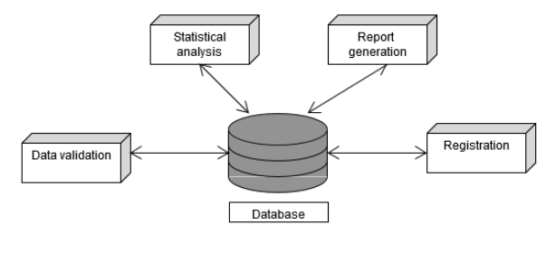
What architecture is shown in the picture? What are the benefits of this architecture?

Slide 12
Module/component
What is a module / component?
How does a module / component differ from an object?

Slide 13
Coupling and cohesion
What is coupling?
What is cohesion?
What is the best coupling between modules?
What is the best cohesion of the module?

Slide 14
questions?

